Slide 1
COVID-19: Situation and perspectives
26th Conference of the Directors General of Customs of the WCO West and Central Africa region
28 and 29 April 2021

Slide 2
COVD-19 Pandemic: WCO Leadership and guidance
Communication
Partner
ships
Capacity Building

Slide 3
WCO Secretariat Initiatives in response to the COVID-19 Pandemic
Section of the WCO web-site dedicated to several guidance materials compiled and developed in response to COVID-19: http://www.wcoomd.org/en/topics/facilitation/activities-and-programmes/natural-disaster/coronavirus.aspx.
Developed a repository of (114) Members best practices and measures in response to Covid-19 pandemic:
i) facilitating the cross-border movement of relief and essential supplies;
ii) supporting the economy and sustaining supply chain continuity;
iii) protecting staff, and
iv) protecting society
Joint initiatives with other International Organizations
Programme support to develop capacity of Customs administrations

Slide 4
WCO Enforcement measures to protect society
Dedicated IPR CENComm group on the CENComm Platform for the exchange of enforcement sensitive information;
Global enforcement operation “STOP”:
Targeting counterfeit pharmaceuticals, substandard medical equipment and fake COVID-19 “cures”
99 participating countries and partners including:
Private sector pharmaceutical industry participation
63 day operational phase from 11 May to 12 July 2020
1,683 seizures/detentions reported by 51 participating countries;
Use of the Global Travel Assessment System (GTAS), nCEN and the Global Rapid Alert Network (GRAN).

Slide 5
Partnerships - highlights
Weekly meetings of the WCO Private Sector Consultative Group (PSCG);
Collaboration with the WHO, UN-OCHA and IFRC;
Joint statements/letters with WTO, IMO, OTIF & OSJD, UPU, UN-OHRLLS, ICC, IRU;
Contributed to the COVID-19 TF Repository;
Contributed to the Global Trade Helpdesk.

Slide 6
Capacity Building
The WCO COVID-19 Project:
Donor: The Government of Japan
Duration: 24 months (July 2020- June 2022)
Objective: To improve the capacity of WCO Members’ Customs administrations business continuity in response to Covid-19 impact.
Main activities:
Develop WCO Guidelines for Customs administrations to address various disruptive scenarios represented by COVID-19, other infectious diseases and natural disasters in order to ensure the stability of global supply chain.
Deliver capacities building activities.
IT solutions to improve the capacity of beneficiary Members.

Slide 7
Capacity Building
The WCO COVID-19 Project:
Achievements to date :
4 regional workshops that covered 5 WCO regions.
Finalized the WCO guidelines whih-ch will be discussed and if appropriate endorsed during the next PTC meeting .
2 national workshops are planned with Madagascar and Ethiopia Customs.
Other activities will be organized for a number of Members in the WCA region
Contact: Covid19BCProject@wcoomd.org

Slide 8
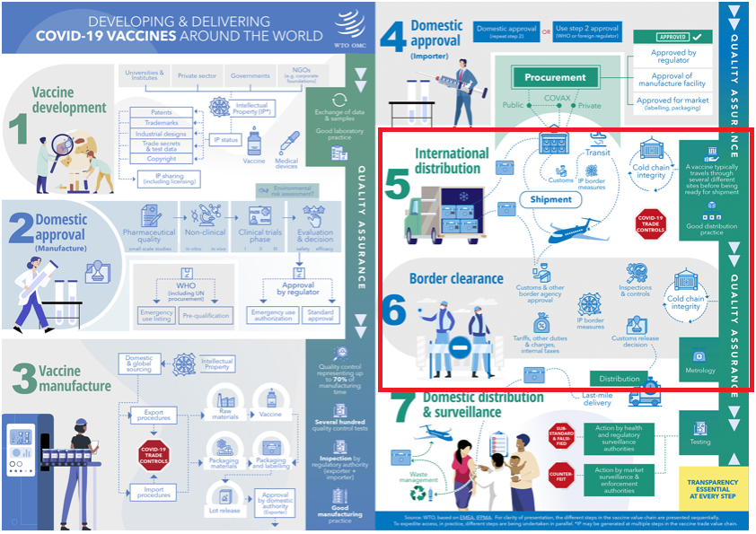
COVID-19 vaccines rollout

Slide 9
WCO Resolution
Resolution of the Customs Co-operation Council on the role of Customs in facilitating the cross-border movement of situationally critical medicines and vaccines, December 2020 [ar]
Preamble
Measures for Customs administrations
Measures for the WCO Secretariat

Slide 10
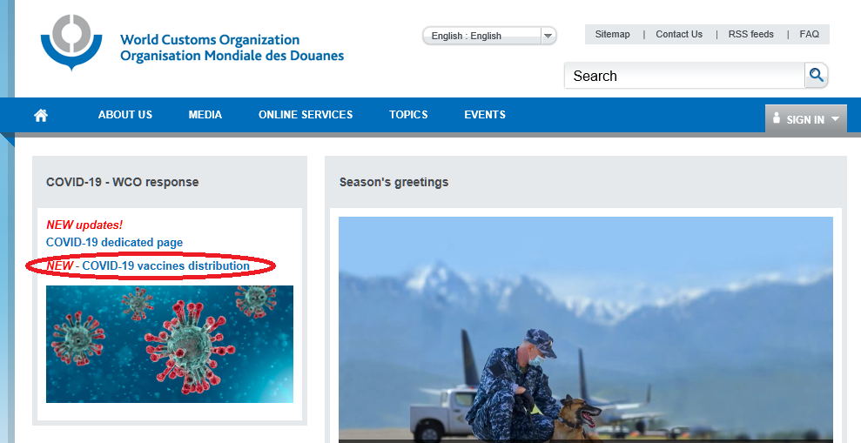
WCO Resolution- implementation
www.wcoomd.org
Dedicated section of the WCO web-site
COVID-19 Action Plan
Dedicated guidance materials - HS Classification reference and a Secretariat Note
Repository of Members’ practices
Joint statement with ICAO
Contributed to the guidelines and information notes issued by IATA and WTO
Information exchanged through an IPR CENComm group
Global webinar series: improving awareness on COVID-19 Vaccines
Operation STOP II

Slide 11
WCO Secretariat note on Vaccines
Coordination with other government agencies and stakeholders;
Measures to prioritize and facilitate the clearance of situationally critical medicines and vaccines;
Measures related to the Customs treatment and handling of specialized containers, devices and goods used for the distribution of situationally critical medicines and vaccines;
Measures related to the control of situationally critical medicines and vaccines;

Slide 12
WCO Secretariat note on Vaccines
Explanations with regard to the measures
WCO instruments and tools
Practical ways to implement the measure
Members’ case studies

Slide 13
Thank you!
Moez Ahmed, COVID-19 Project Manager, C & F Directorate, WCO (moez.ahmed@wcoomd.org)
More infos, please contact : facilitation@wcoomd.org

